Slide 1
Jussi Tohka – research 5 min
Professor of Biomedical Image Analysis – A.I. Virtanen Institute

Slide 2
Research field
Biomedical image computation
  Segmentation
  Registration
  Predictive models
Application to predictive models of brain diseases
  Dementia/cognitive decline
  Epilepsy

Slide 3
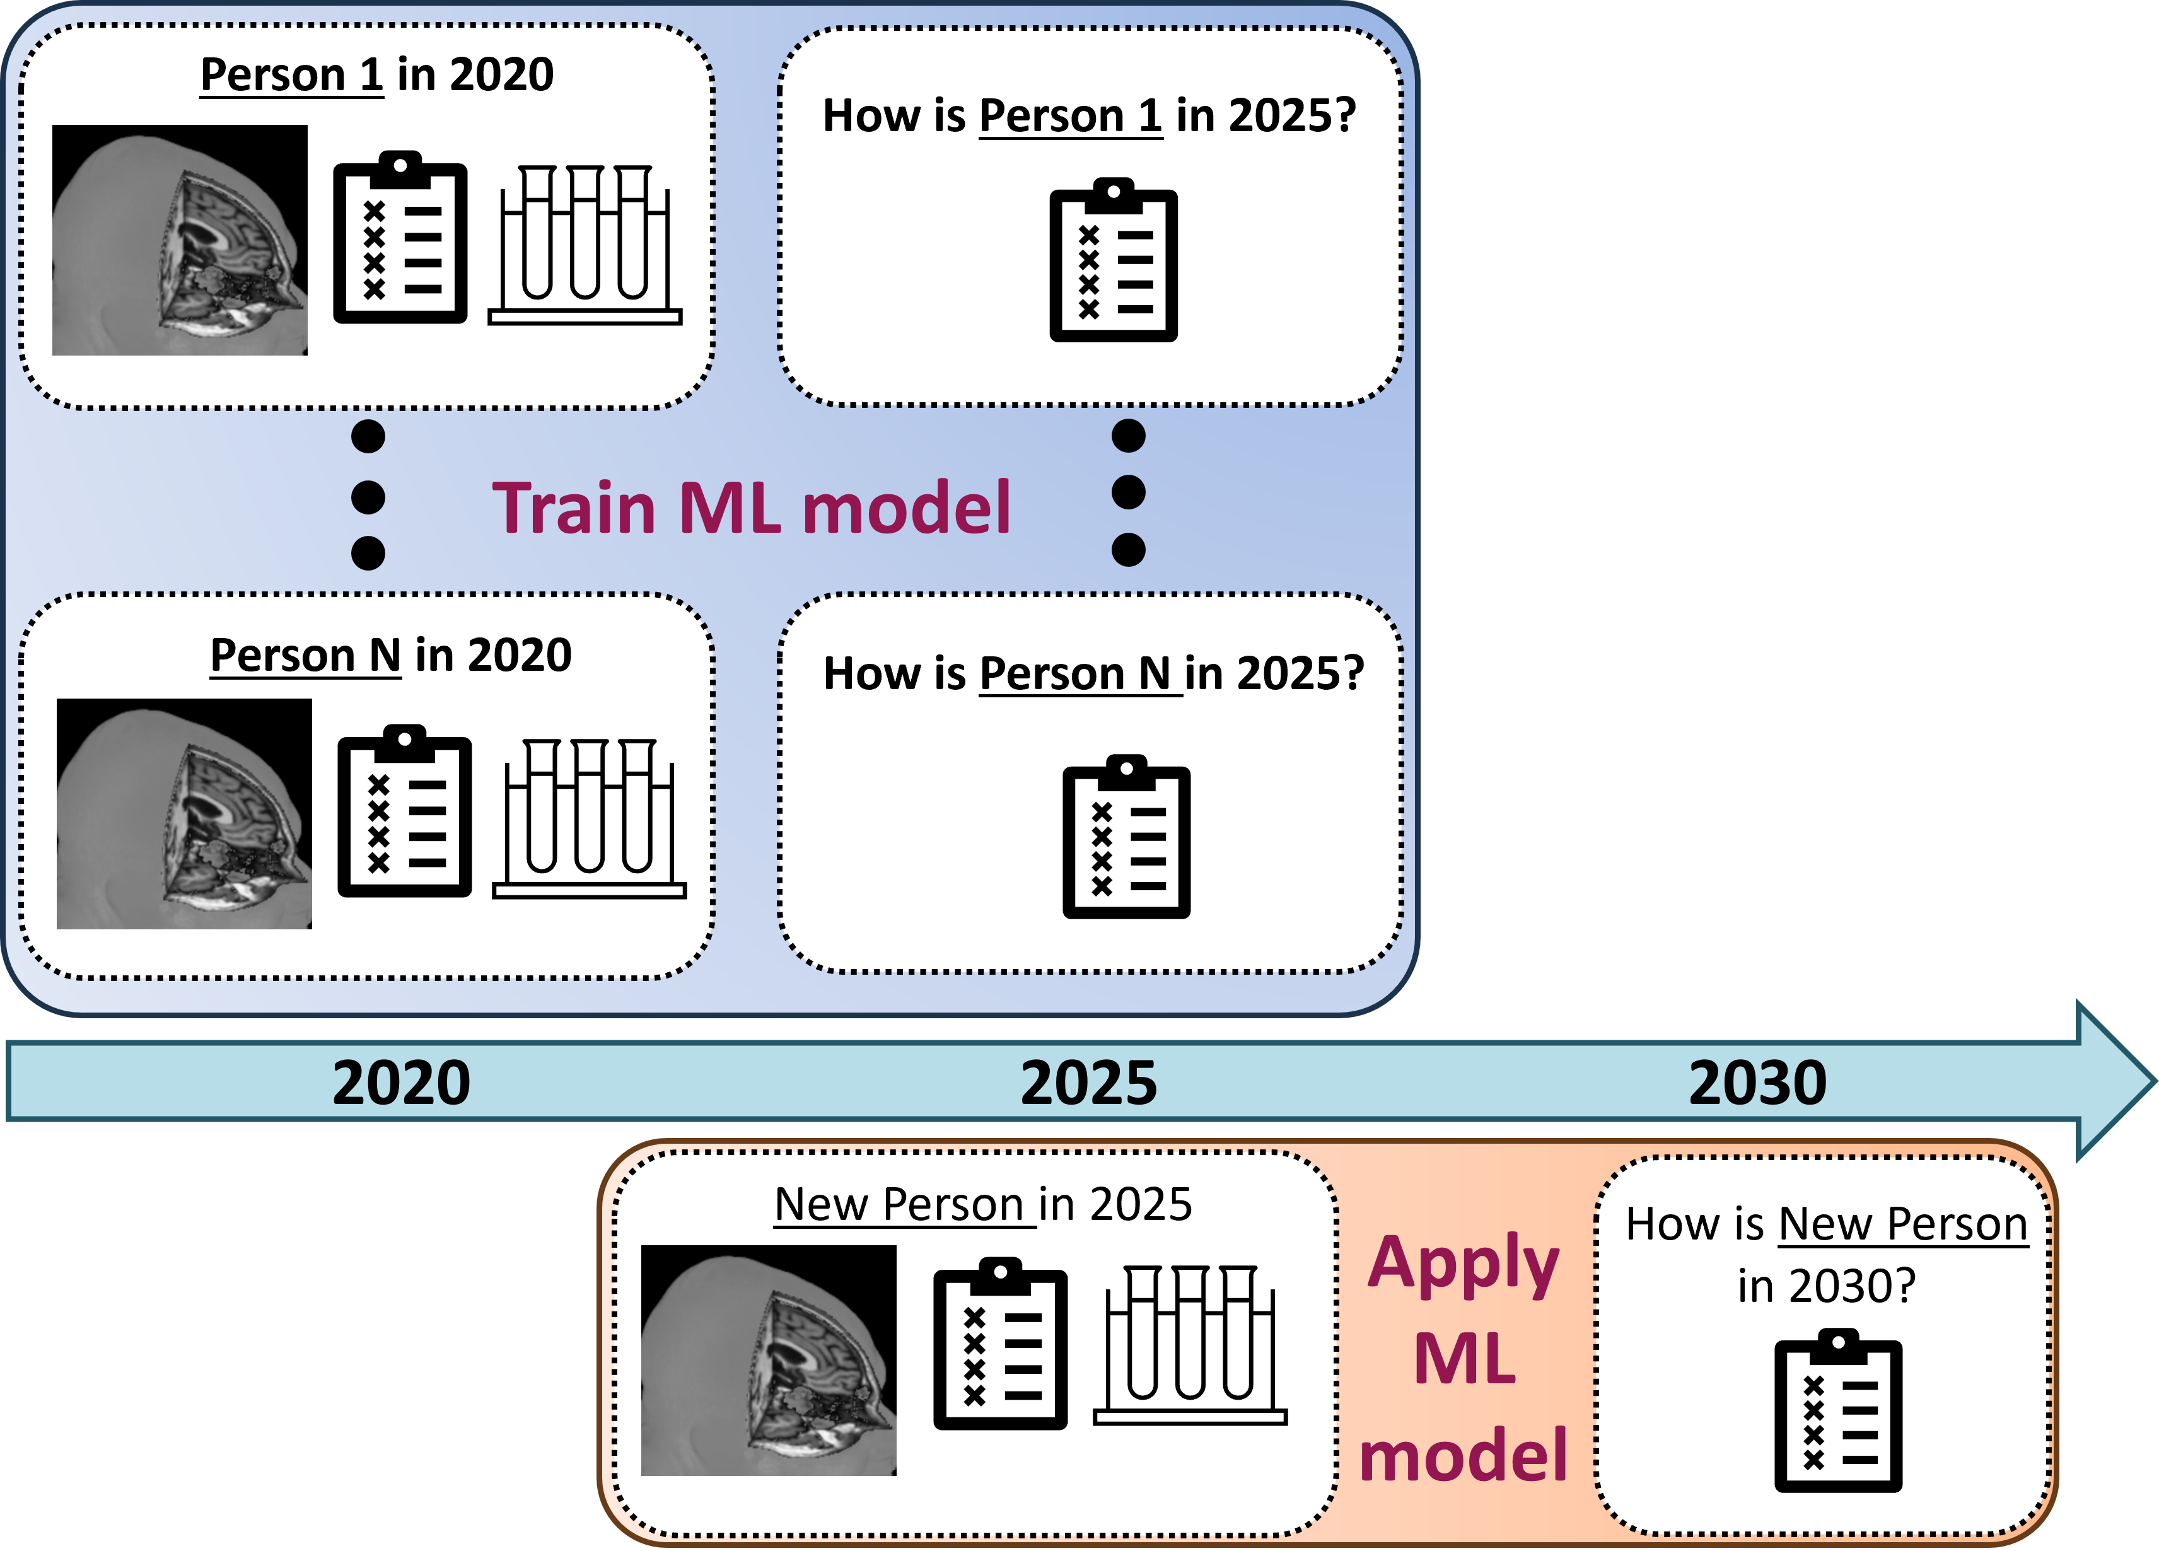
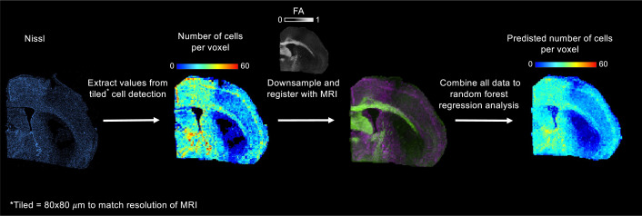
Research topic
Personalized predictive models of brain health require imaging markers
Three ways to improve imaging markers
  Using AI and large image databases to train advanced predictive models
  Improved image quantification
  Enhancing the imaging itself
Gröhn et al Frequency-dependent diffusion tensor distribution imaging in the evaluation of ischemic stroke, Neuroscience informatics 2026

